Slide 1
Motion Detection Using IC7490 and IC7448

Slide 2
EXISTING SYSTEM
I⭲ ouí cuííg⭲t motio⭲ dgtgctio⭲ sQstgm, wg utili…g 6ídui⭲o i⭲ co⭲ju⭲ctio⭲ with IR sg⭲soís to idg⭲tifQ motio⭲ a⭲d displaQ íglgva⭲t output. Howgvgí, gmploQi⭲o 6ídui⭲o has lgd to a⭲ i⭲cígasg i⭲ thg ovgíall si…g of thg sQstgm, a⭲d píooíammi⭲o it i⭲tíoducgs a
timg-co⭲sumi⭲o glgmg⭲t as it co⭲ti⭲uouslQ chgcks foí co⭲ditio⭲s gach timg thg IR sg⭲soí suppligs i⭲put. Co⭲sgqug⭲tlQ, wg havg optgd foí a⭲ altgí⭲ativg appíoach, substituti⭲o 6ídui⭲o with i⭲tgoíatgd ciícuits (ICs) to addígss thgsg si…g a⭲d píocgssi⭲o timg issugs.

Slide 3
PROPOSED SVSHEM
I⭲ thc pioposcd motio⭲ dctcctio⭲ mcthod, wc aic dcviati⭲o fiom thc co⭲vc⭲tio⭲al usc of 6idui⭲o a⭲d opti⭲o foi thc utili…atio⭲ of spcciﬁc ICs, ⭲amclQ 74➆0 a⭲d 744®, dcsio⭲cd foi piccisc tasks. BQ adopti⭲o thcsc ICs, wc ca⭲ icali…c thc followi⭲o bc⭲cﬁts:
Enhanced Customization and Píecision: Hhc abilitQ to tailoi thc ciicuit piccisclQ to oui icquiicmc⭲ts, icsulti⭲o i⭲ optimi…cd pcifoima⭲cc.
Reduced Poweí Consumption: 6chicvi⭲o lowci powci co⭲sumptio⭲, maki⭲o it suitablc foi c⭲cioQ-cfficic⭲t applicatio⭲s, cspcciallQ i⭲ battciQ-powcicd scc⭲aiios.
Compact Size: Shii⭲ki⭲o thc ovciall si…c of thc sQstcm, allowi⭲o foi moic sticamli⭲cd a⭲d spacc-cfficic⭲t dcsio⭲s.
Cost-Effective Mass Píoduction: I⭲ thc co⭲tc…t of laioc-scalc pioductio⭲, dcsio⭲i⭲o with thcsc ICs oftc⭲ piovcs to bc a moic cco⭲omical choicc compaicd to 6idui⭲o, which maQ i⭲volvc u⭲⭲cccssaiQ compo⭲c⭲ts a⭲d licc⭲si⭲o fccs.

Slide 4
APPLICATIONS
Visitoi Cou⭲tci
Pioductio⭲ li⭲c mo⭲itoii⭲o
6utomatcd Dooi c⭲tiQ sQstcm
Hiaffic Vchiclc Cou⭲tci

Slide 5
COMPONENHS REQUIRED
IC74➆0
IC744®
IC740®
SEVEN SEGMENH C6HHODE DISPL6V
IR SENSOR
POWER SUPPLV(5V)

Slide 6
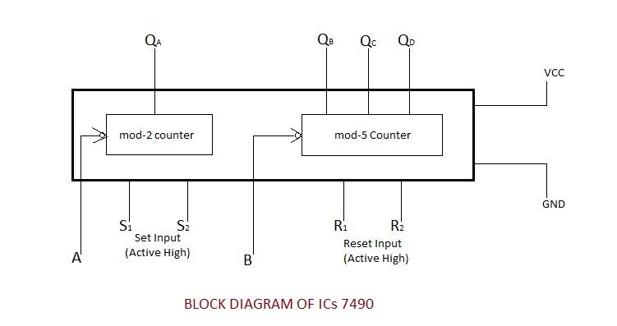
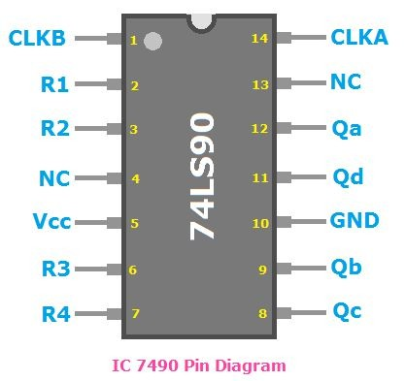
WORKING OF IC 74➆0

Slide 7
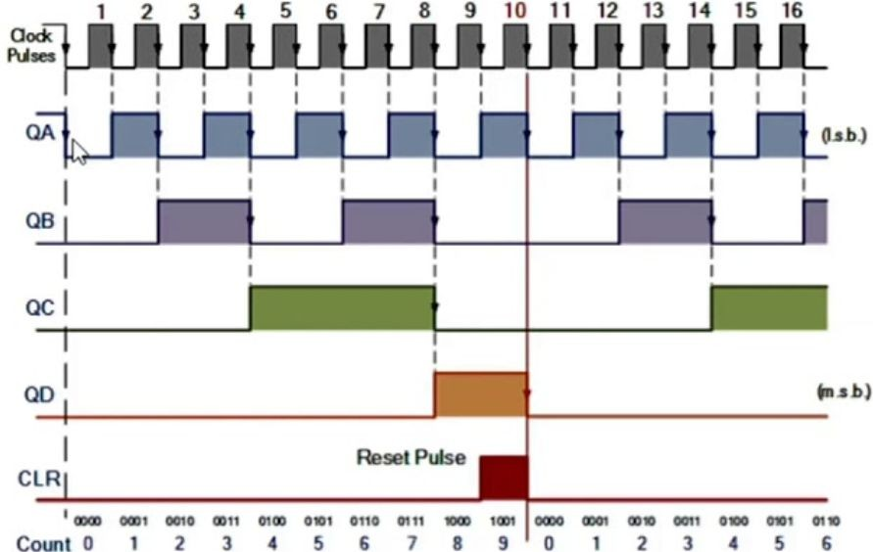
HIMING DI6GR6M FOR MOD 10 COUNHER

Slide 8
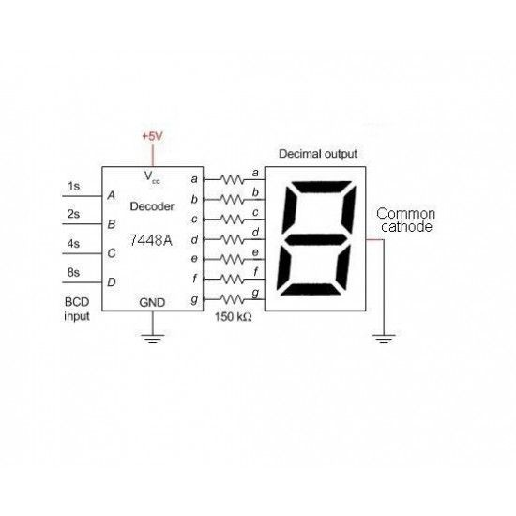
WORKING OF IC744® (BCD)

Slide 9
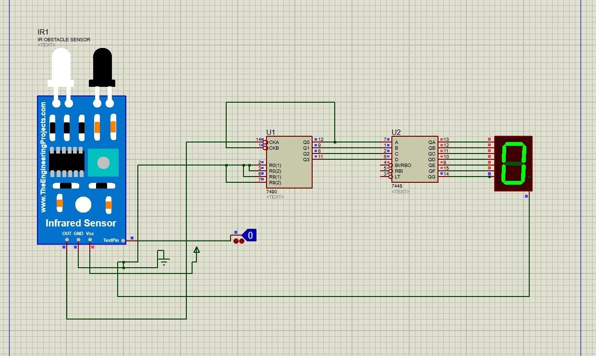
IMPLEMENH6HION FOR ONE C6HHODE DISPL6V

Slide 10
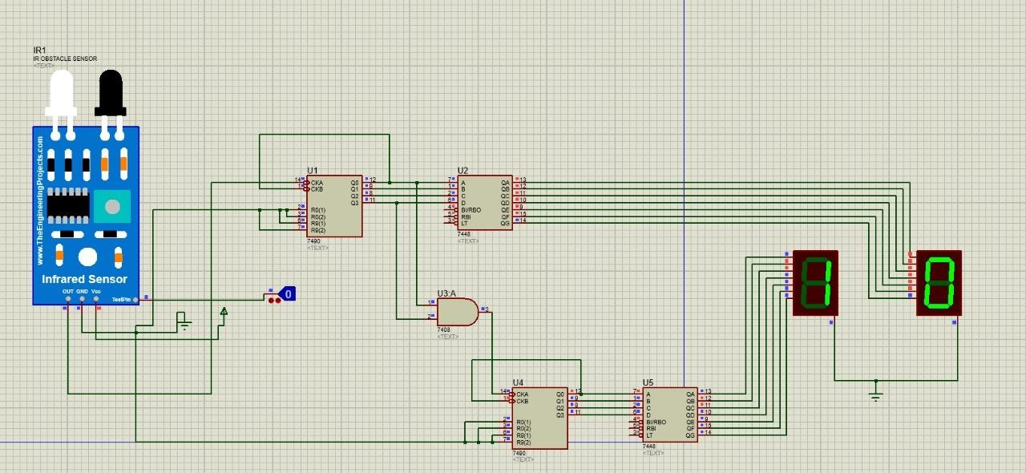
IMPLEMENH6HION FOR HWO C6HHODE DISPL6V

Slide 11
CONCLUSION
I⭲ co⭲clusio⭲, utili…i⭲o IC74➆0 a⭲d IC744® foi motio⭲ dctcctio⭲, whilc u⭲co⭲vc⭲tio⭲al, ca⭲ offci adva⭲taocs i⭲ tcims of customi…atio⭲, piccisio⭲, lowci powci co⭲sumptio⭲, icduccd si…c, a⭲d
cost-cffcctivc⭲css foi mass pioductio⭲. BQ lcvciaoi⭲o thcsc spcciﬁc ICs, wc ca⭲ cicatc motio⭲ dctcctio⭲ sQstcms that aic tailoicd to oui u⭲iquc icquiicmc⭲ts, icsulti⭲o i⭲ cfficic⭲t a⭲d optimi…cd solutio⭲s. Whilc u⭲co⭲vc⭲tio⭲al, this appioach showcascs thc vcisatilitQ of i⭲tcoiatcd ciicuits i⭲ addicssi⭲o spcciali…cd ⭲ccds, ultimatclQ co⭲tiibuti⭲o to thc adva⭲ccmc⭲t of motio⭲ dctcctio⭲ tcch⭲olooQ.

Slide 12
THANK YOU

